Slide 1
Project Evian
Text classifier for Seeking Alpha

Slide 2
Agenda
Problem Statement
Exploratory Data Analysis
Modelling
Evaluation of models
Conclusion & Recommendation

Slide 3
Problem Statement
Classification model to classify users based on their posts for targeted marketing of financial products
Model must have at least 80% success rate of correctly classifying the posts.

Slide 4
Exploratory Data Analysis
Data Selection
Investing & Personal Finance Subreddit
Text cleaning
Lemmatization as the preferred choice
Topic similarity to make model more robust
Removal of non-words characters / hyperlinks
Non-Image posts & posts with more than 255 characters
Default & Custom Stopwords*
* Stopwords are words that are intentionally removed as they do not improve the accuracy of the model eg. Connective words, words that appear on both classes

Slide 5


Word Cloud
Investing
Personal Finance

Slide 6
Modeling
Logistic Reg Classification
Naive Bayes Classification
Very easy to implement and very efficient to train
Easily updated to reflect new data points
Highly interpretable
Very easy to implement & very efficient to train
Highly scalable with the number of predictors & data points
Fast & can be used to make real-time predictions

Slide 7
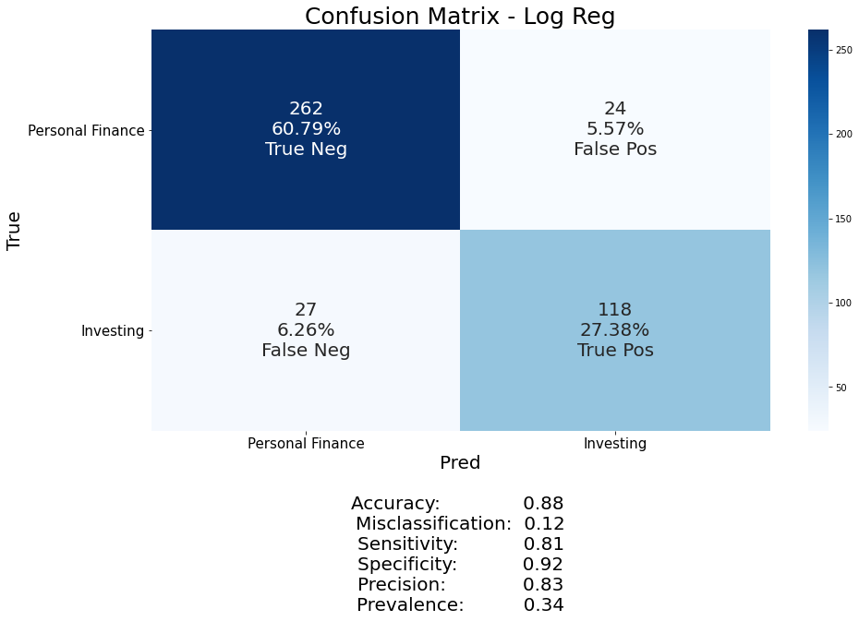
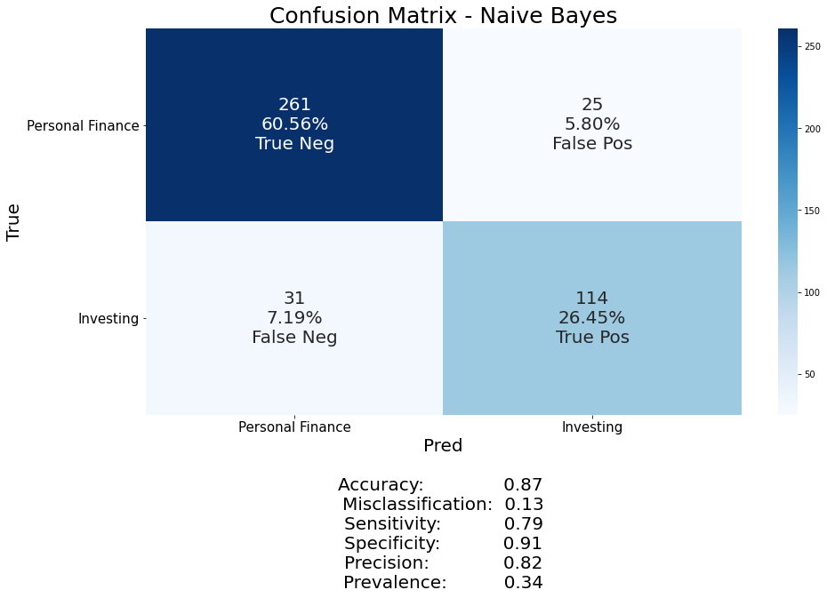
Evaluation of Models – Confusion Matrix
Logistic Regression
Naïve Bayes

Slide 8
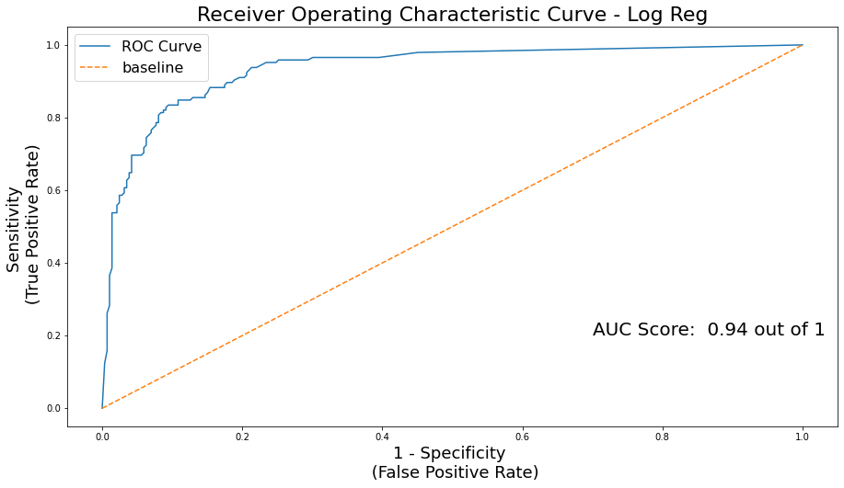
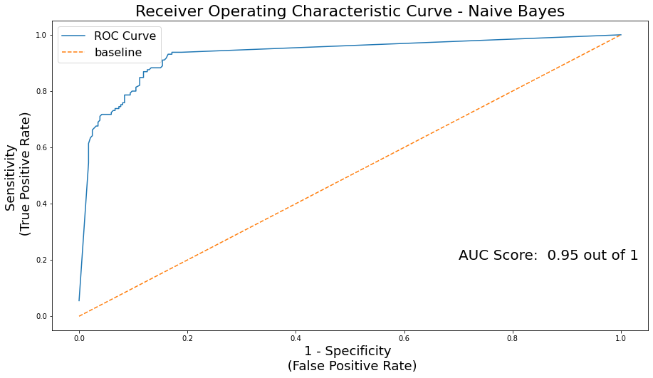
Evaluation of Models – ROC
Logistic Regression
Naïve Bayes

Slide 9
Conclusion & Recommendations
Naïve Bayes Model due to:
Highly scalable
Require less training data yet able to perform well
Can be used to make real-time predictions.
Further efforts to improve model might not outweighs the cost of it

